Slide 1

The marketing Project Egyptian Oriental Food Restaurant Chain Bayt Gedi

Slide 2
Agenda Style
01
Project Introduction
Project Introduction and Initiation Phase
02
Project Details
Project Management Plan
03
Time Schedule on Microsoft Project

Slide 3
Project Introduction
Project Introduction and Initiation Phase

Slide 4
Project Introduction
Project Introduction
Development and Execution of a Marketing Plan to Increase Sales for the Egyptian Oriental Food Restaurant Chain Bayt Gedi
Project Objective:
The objective of this project is to develop and implement a comprehensive marketing plan that will increase the total sales of the restaurant chain from EGP 30 million to EGP 150 million within a 2month period. This will be achieved by leveraging targeted marketing strategies, optimizing brand visibility, and enhancing customer engagement.

Slide 5
Project Introduction
Project Introduction
Scope Description:
This project covers the development and execution of a marketing plan designed to drive a fivefold increase in sales. Key components of the plan will include digital marketing, promotional campaigns, customer loyalty programs, The project will also focus on enhancing brand visibility, increasing customer footfall in physical locations, and boosting online order volumes.
Traditional
Tv ad
Social Media
Such as brochures handed in the street and street signs
TV ad to broadcast in Ramadan month
Social Media presence on Facebook, Instagram and TikTok

Slide 6
Project Introduction
Project Introduction
Project Constrains:
Strict 2-month timeline for achieving sales targets.
This project estimated budget is 9,500,000 EGP
Marketing strategies must be adapted to Egypt’s cultural and social context.
Time
Scope
Cost
Quality

Slide 7
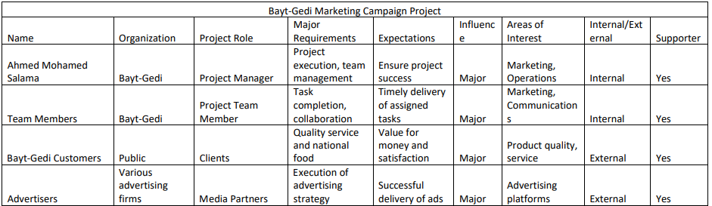
Project Introduction
Project Initiation
Stakeholders Register Sample

Slide 8
Project Introduction
Project Initiation
The marketing Project Egyptian Oriental Food Restaurant Chain Bayt Gedi
WBS
Traditional Ads
Tv ad
Social Media
Brochures
Street Signs
Ramadan Ad
SM Ads
Influencers

Slide 9
Project Details
Project Management Plan

Slide 10
Project Details
Project Management Plan
Traditional Ads:-
Estimated Total Cost Breakdown(printing street ads): Printing street ads: (forty six print ads). Total Estimated Cost: 700,000 EGP. -Duration: 1 weak
Estimated Total Cost Breakdown(distribution street ads): Total Estimated Cost monthly : 5,700,000 EGP. -Duration: 4 weak
Brochures: Basic Brochures. High-Quality Brochures. Total Estimated Cost: 500,000 EGP Estimated Cost distribution Brochures : 100,000 EGP -Duration: 5 weak
gifts: Kids’ Toys. Promotional Items. Total Estimated Cost: 345,000 EG Duration: 4 weak

Slide 11
Project Details
Project Management Plan
Tv ad:-
CreativeDevelopment, Script and TV Commercial Production :
Total Cost: 170,000 EGP. -Duration: 2weeks.
Lunch ads onTV channels :
Total Cost: 2,240,000 EGP. - Duration: 4 weeks .
Total Estimated Cost : 2,410,000 EGP.
Total Duration : 6weeks.

Slide 12
Project Details
Project Management Plan
Social Media:-
Rebranding design:-
- Total Cost:- 40,000$ . - Duration: 1week
Photography company :-
-Total Cost:- 30,000$ . - Duration: 1week
Marketing campaign:-
-Total Cost:- 90,000$ . - Duration: 7weeks
Ads and influancers:-
-Total Cost:- 400,000$ . - Duration: 3weeks
Total Estimated cost:- 560,000 $
Total Duration 9 weeks .

Slide 13
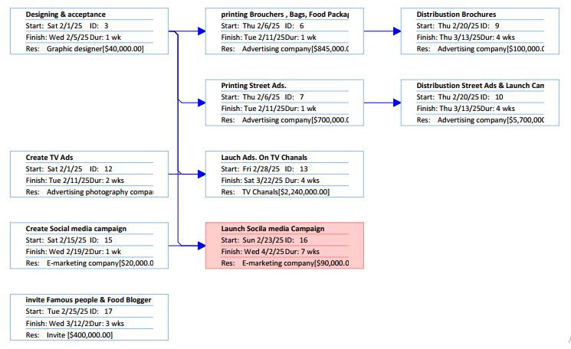
Project Details
Project Management Plan
Time Schedule (Network Diagram)

Slide 14
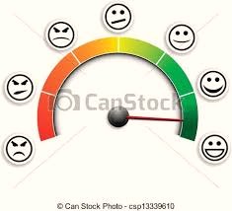

Project Details
Project Management Plan
Quality Assurance Plan
When evaluating brochures, advertisements, and street designs, several key criteria can be considered:
1- The content of the advertisement
2- The design of the advertisement
3- The effectiveness of the advertisement

Slide 15
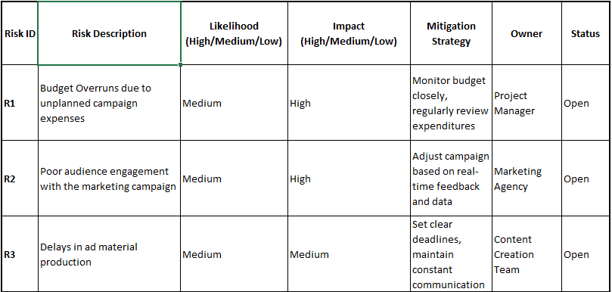
Project Details
Project Management Plan
Risk Register Sample

Slide 16
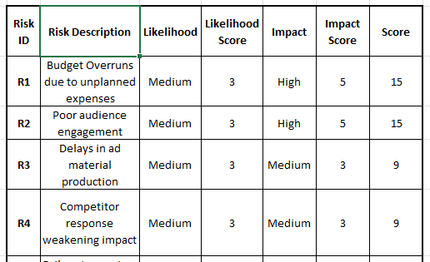
Project Details
Project Management Plan
Risk Score

Slide 17
Time Schedule on Microsoft Project

Slide 18

Time Schedule on Microsoft Project
Project Time Schedule built using Microsoft Project

Slide 19
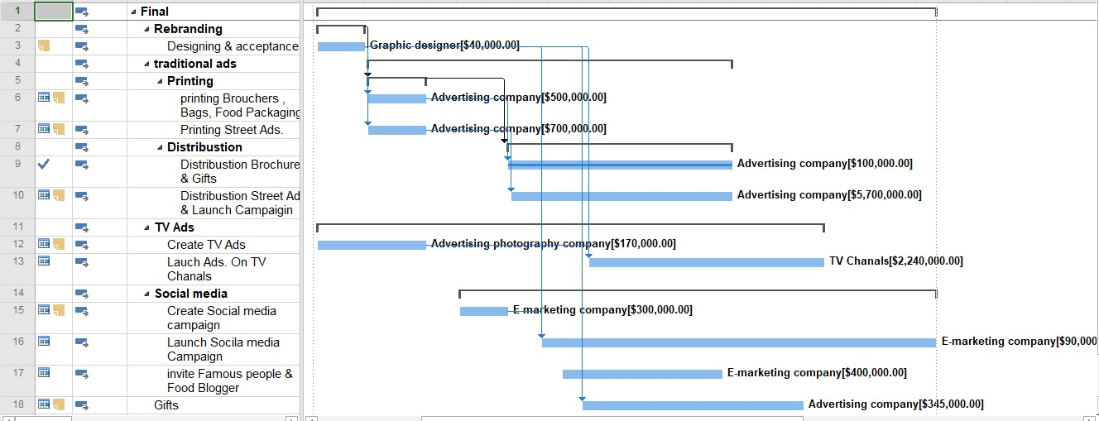
Time Schedule on Microsoft Project

Slide 20
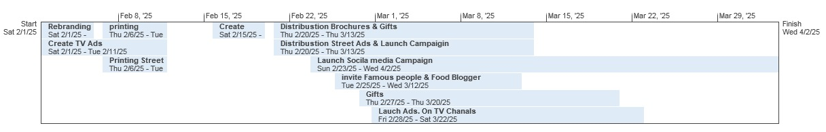
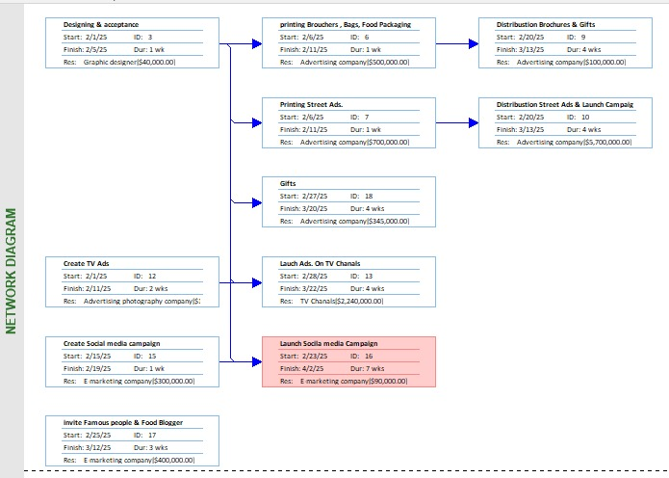
Time Schedule on Microsoft Project

Slide 21
Prepared by
Mohamed Abdel Karim Ali
Ahmed Salama
Mahmoud AbdelFatah
Sara Saeed
Osama Sangab
Marko Abdalla
Mahmoud Fakhry

Slide 22
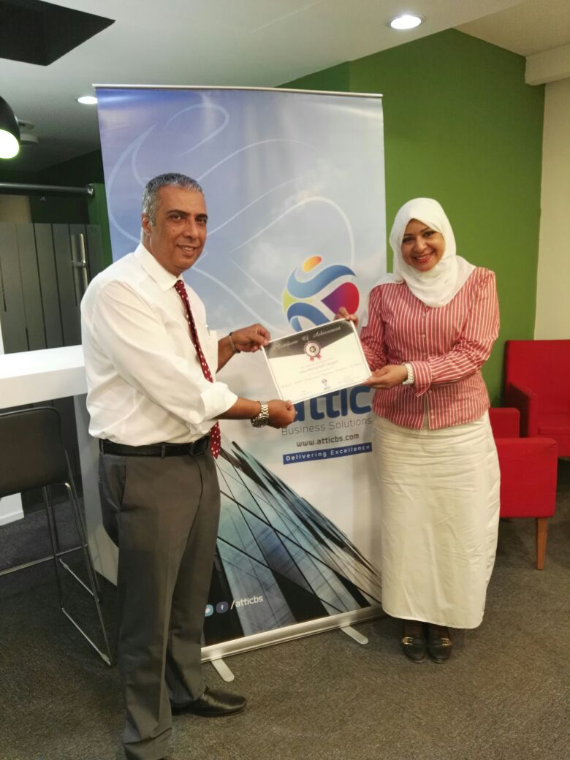
Special Thanks to Dr. Mohamed Seleam
For his hard work and dedication he has given to the group. And for his continuous support during all phases of the grant

Slide 23
Thank you for you attention

